Slide 1

Computer graphics
Tutorial 4
WebGL and ThreeJS
Miryala Narayana Reddy
CVIT

Slide 2


API (Application programming interface)
rendering 2D and 3D graphics (vectors).
interacts with GPU for Hardware accelerated rendering
Managed by Khronos Group.

Slide 3

Web Graphics Library (WebGL)
Javascript API
Use of GPU-accelerated physics and image processing and effects.
Graphics code and logic is written in JavaScript.
HTML 5
DOM (document object model)
Canvas element.
<canvas id="example" width="200" height="200">
This text is displayed if your browser does not support HTML5 Canvas.
</canvas>
WebGL is widely supported by modern browsers.

Slide 4
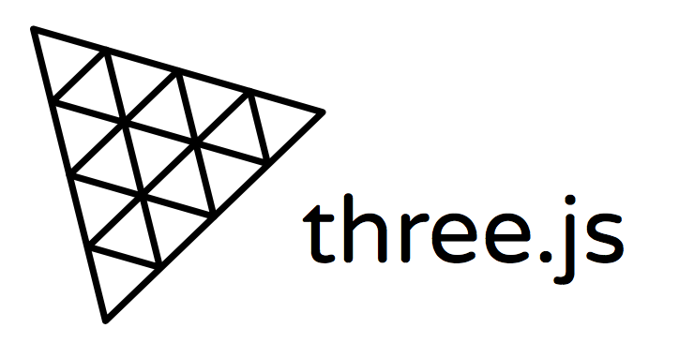
High level Javascript Library which uses WebGL.
WebGL is a low-level graphics API created specifically for the web.
https://threejs.org/

Slide 5

Setup/ Running three.js
We will use npm to install Threejs library
  npm install three
  npm install webpack
  sudo npm -g install servez
  Servez .

Slide 6

Webpack is a static module bundler used for JavaScript applications.
It is made primarily for JavaScript.
https://webpack.js.org/

Slide 7

Assignment 2

Slide 8

This Photo by Unknown author is licensed under CC BY.

